Slide 1
Adatkezelő programok fejlesztése (INBGM0528L-03) 2020.ősz 4. beadandó feladat – 02/12/2020
Bene Bálint – GOGL11 – DE-IK GI BSc nappali

Slide 2
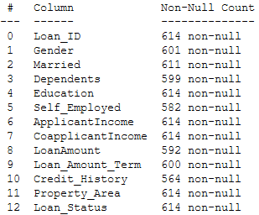
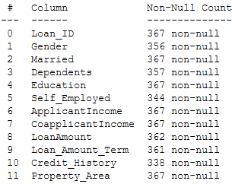
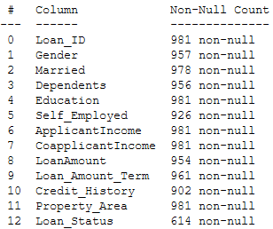
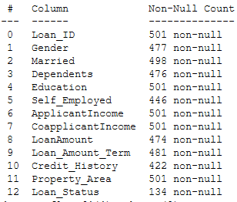
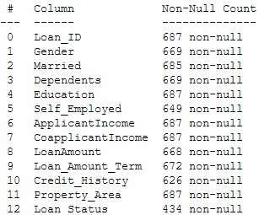
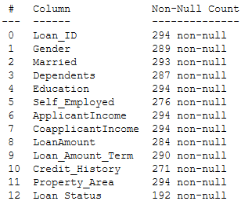
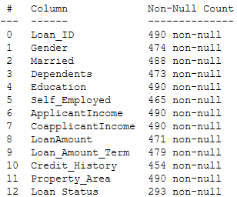
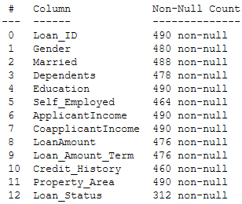
Adatok részekre bontása
Train
Test
Appended(train + test)
Blind(NaNs)
Train70
Test30
Train50
Test50
+ futásonként változó random arányú adathalmazok

Slide 3
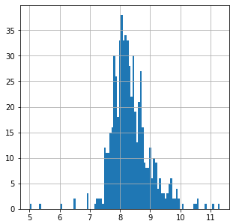
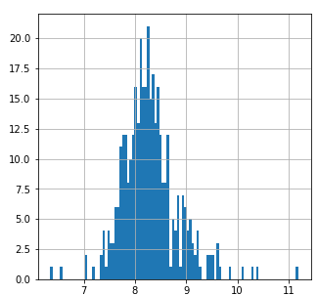
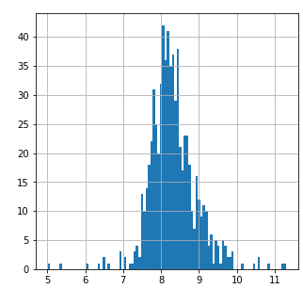
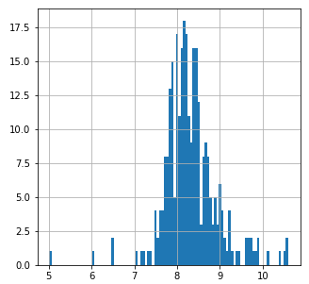
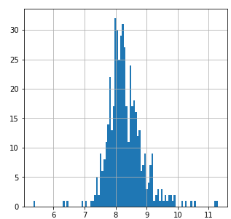
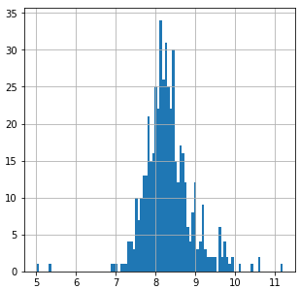
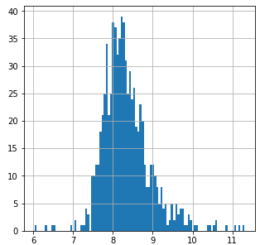
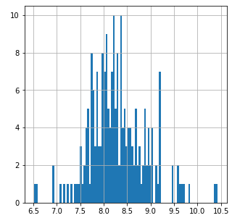
Logaritmikus simítás ApplicantIncome attribútumon
Train
Test
Train70
Test30
Train50
Test50
Random
Train
Test

Slide 4
Tanítás
model | outcome | prediction | train | train70 | train50 | trainrandom | blind
Log.Reg | Loan Status | Credit hist | 80.945 | 51.82 | 52.041 | 50.485 | 73.253
Log.Reg | Loan Status | Education | 68.73 | 45.415 | 43.469 | 43.042 | 73.253
Log.Reg | Loan Status | Credit hist,Gender, Married, Education,LoanAmount_log | 80.945 | 51.528 | 51.02 | 49.73 | 73.253
Dec.Tree | Loan Status | Credit hist,Gender, Married, Education,LoanAmount_log | 93.322 | 83.115 | 86.531 | 84.286 | 91.018
Rand.Forest(n=100) | Loan Status | Gender,Married,Dependents, Education, Self_Employed, Loan_Amount_Term, Credit_History, Property_Area,LoanAmount_log | 99.349 | 97,926 | 98.776 | 97.143 | 97.605
Rand.Forest(n=25) | Loan Status | LoanAmount_log,Credit_History,'Dependents,Property_Area,Married,Education | 81.433 | 60.408 | 59.592 | 58.057 | 74.052

